Slide 1
ROAD TRANSPORT TREND AND INSIGHTS
A Comprehensive Analysis of 2023 Data
ARIJEH OLAYINKA OLUWASEYI
28TH APRIL 2024

Slide 2
AGENDA
Introduction
Objectives
Methodology
Data Overview
Key Insights
Recommendations
Conclusion
Q&A

Slide 3
INTRODUCTION
The year 2023 has seen significant advancements and challenges in the realm of road transport. As we delve into the analysis of road transport data for this period, it becomes evident that understanding these trends is paramount for ensuring road safety, optimizing infrastructure, and enhancing overall transportation efficiency.
In this presentation, we will explore the key insights derived from our analysis of road transport data in 2023, using reports from Q1 to Q4. By examining various factors such as accident severity, contributing factors, and infrastructure conditions, we aim to gain a comprehensive understanding of the state of road transport and identify opportunities for improvement.

Slide 4
OBJECTIVES
To Analyze Accident Trends: Our primary objective is to analyze the trends and patterns of road accidents in 2023, including factors such as accident severity, frequency, and geographic distribution.
To Identify Contributing Factors: We seek to identify the key factors contributing to road accidents, including speed violations, alcohol/drug involvement, road infrastructure deficiencies, and other relevant parameters.
To Provide Insights for Decision-Making: By uncovering insights from the data analysis, our goal is to provide actionable recommendations to stakeholders and decision-makers in the transportation sector. These insights will aid in the formulation of policies and interventions aimed at improving road safety and optimizing transportation systems.
To Enhance Road Safety: Ultimately, our objective is to contribute to the overarching goal of enhancing road safety and reducing the incidence of road accidents. Through data-driven insights and evidence-based recommendations, we aim to support initiatives that promote safer and more efficient road transport systems.

Slide 5
METHODOLOGY
Data Collection: The first step in our analysis involved collecting road transport data for Q1, Q2,Q3 and Q4 from the national bureau of statistics database nigeria. This included data on road accidents, traffic violations, road infrastructure, weather conditions, and other relevant parameters.
Data Preprocessing: Once the data was collected, we conducted preprocessing tasks to first achieve comprehensive road transport data for the year 2023, cleaning and prepare the data for analysis. This involved handling missing values, correcting inconsistencies, and standardizing data formats to ensure uniformity across datasets. Additionally, we performed data transformation and normalization where necessary to enhance the quality of the data.
Exploratory Data Analysis (EDA): EDA was conducted to gain initial insights into the characteristics and distribution of the data. This involved the use of descriptive statistics, data visualization techniques, and exploratory plots to identify patterns, trends, and outliers in the data. EDA helped us understand the underlying structure of the data and guided subsequent analysis.
Statistical Analysis: We employed various statistical methods to analyze the relationships between different variables and their impact on road transport outcomes. This included regression analysis, correlation analysis, hypothesis testing, and other statistical tests to identify significant factors influencing accident severity, frequency, and other outcomes.
Interpretation and Insights: Finally, we interpreted the results of our analysis to derive actionable insights and recommendations for stakeholders and decision-makers in the transportation sector. This involved synthesizing the findings from statistical analysis and exploratory data analysis to provide a comprehensive understanding of the state of road transport in 2023 and opportunities for improvement.

Slide 6
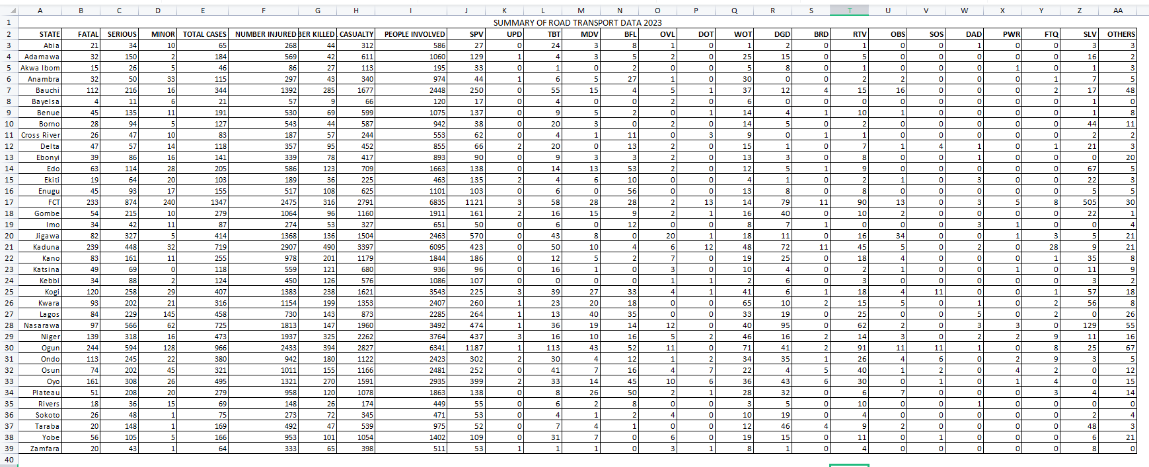
DATA OVERVIEW

Slide 7
Data Overview:
Road Accident Data: The primary dataset includes information on road accidents that occurred during Q1 to Q4 in the year 2023. This dataset contains details such as the states, total cases, severity (fatal, serious and normal), casualties (injured and killed) and contributing factors (e.g. speeding, alcohol involvement, road and weather conditions etc). It provides a comprehensive view of the frequency, distribution, and characteristics of road accidents across different states in the country.
10,604 number of cases in 2023.
36,954 number of casualties in 2023.

Slide 8
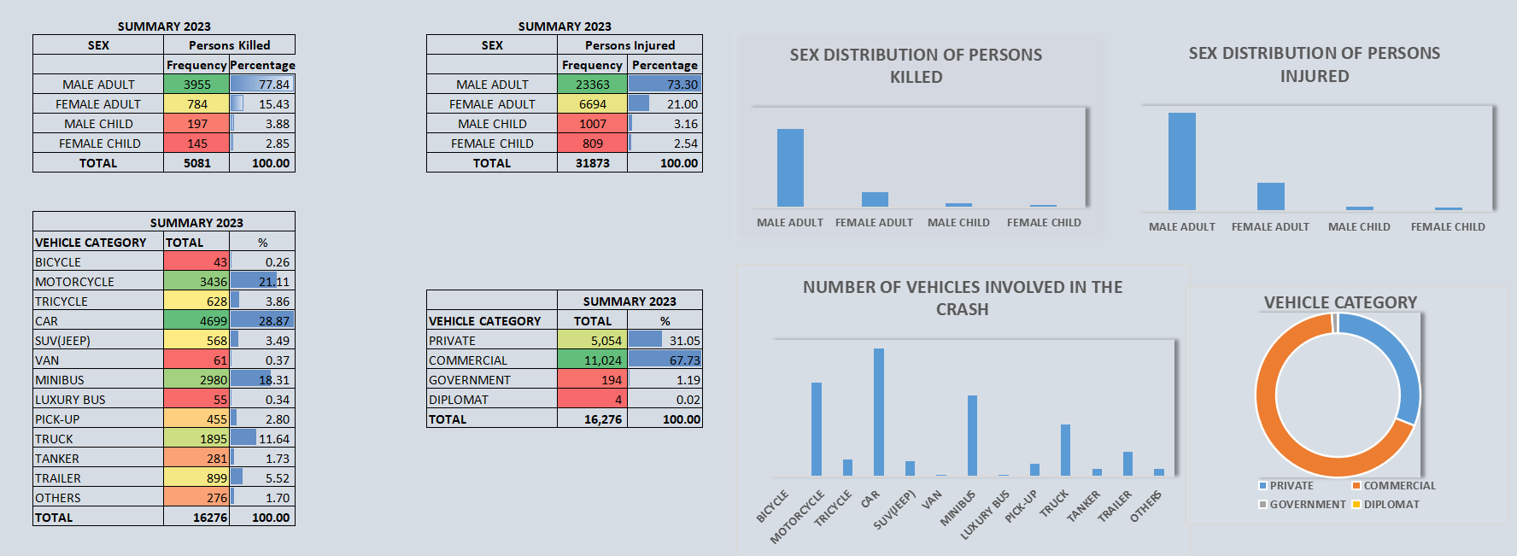
CASUALTIES AND CRASHED VEHICLES

Slide 9
Key insights:
Hightest percentage of victims of crashes both injured and killed were male adults.
Least percentage were female children.
Recorded 16,276 crashed vehicles.
67% commercial cars/vehicles.
31% private cars/vehicles

Slide 10
CAUSATIVE FACTOR CODE
1. Speed Violation (SPV) 11. Use of Phone While Driving (UPWD)
2. Tyre Burst (TBT) 12. Brake Failure (BFL)
3. Mechanically Deficient Vehicle (MDV) 13. Driving Under Alcohol/Drug Influence (
4. Overloading (OVL) 14. Poor Weather (PWR)
5. Dangerous Overtaking (DOT) 15. Fatigue (FTQ)
6. Wrongful Overtaking (WOT) 16.Sign Light Violation (SLV)
7. Dangerous Driving (DGD) 17. Others (OTH)
8. Bad Road (BRD)Route Violation (RTV)
9. Road Obstruction Violation (OBS)
10 Sleeping on Steering (SOS)

Slide 11
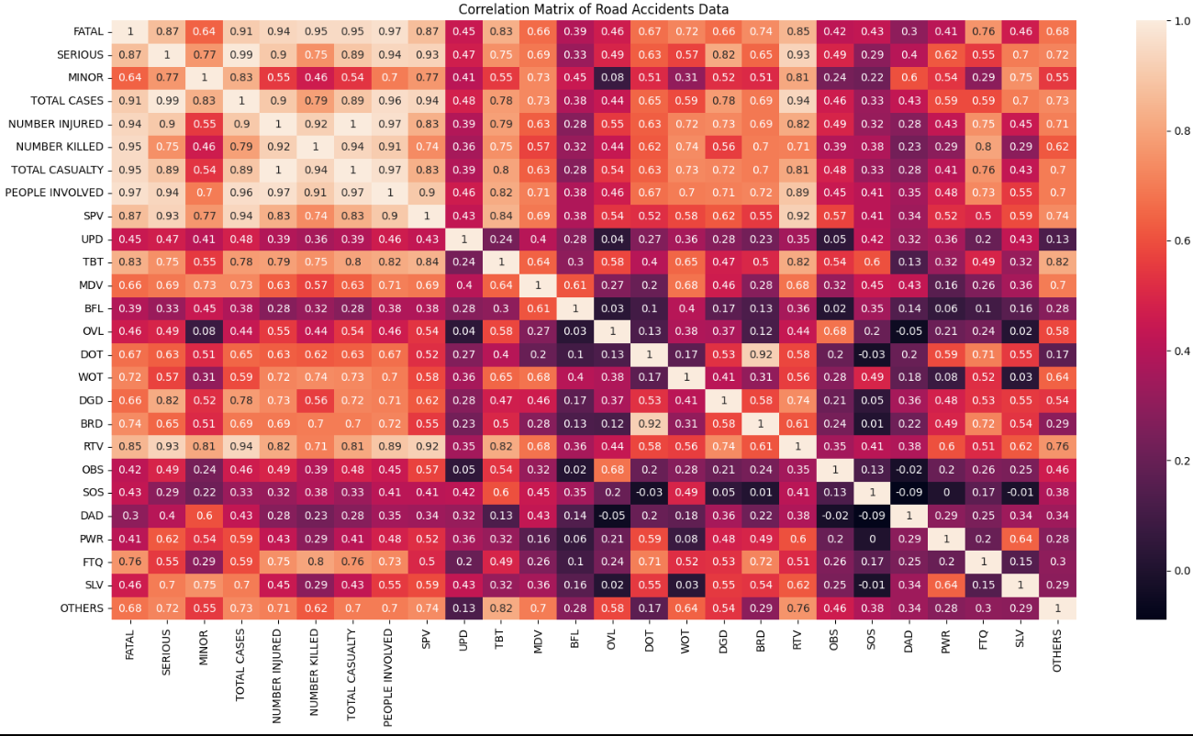

CORRELATION MATRIX

Slide 12
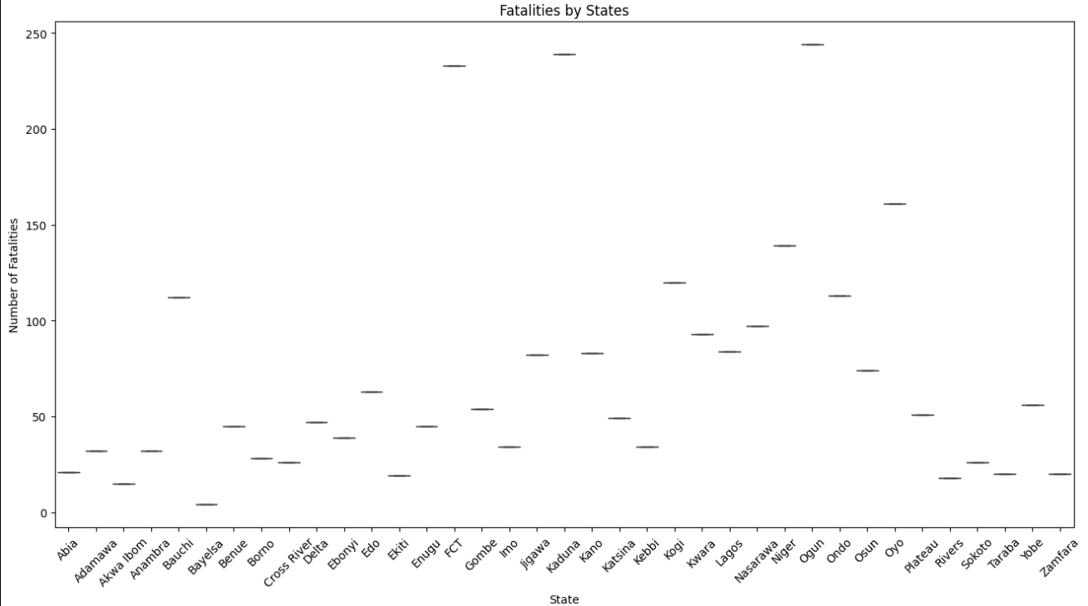
FATAL CRASHES BY STATES

Slide 13
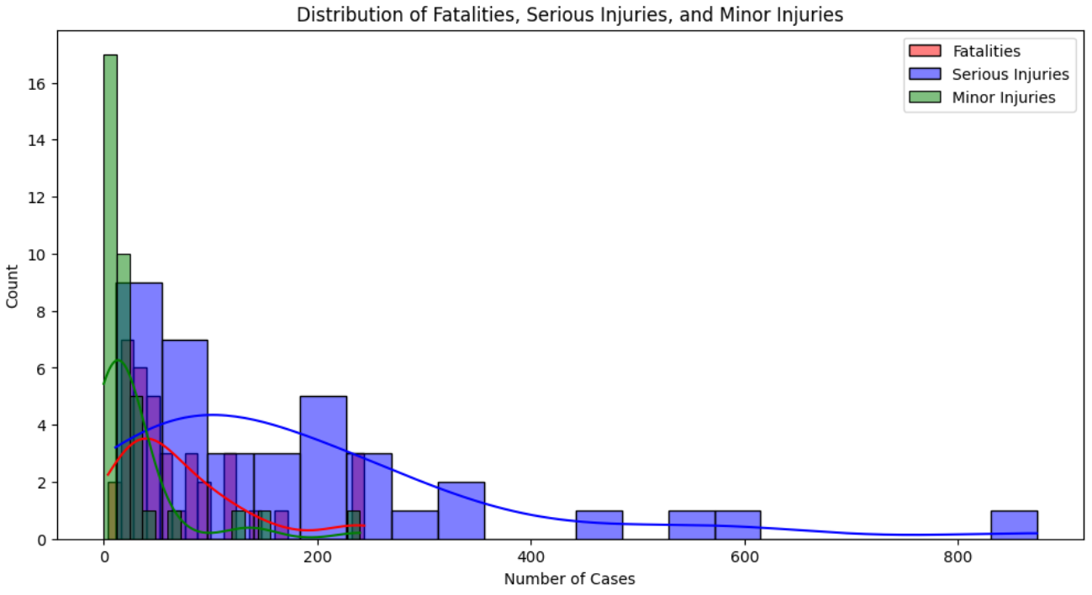
SEVERITY DISTRIBUTION

Slide 14
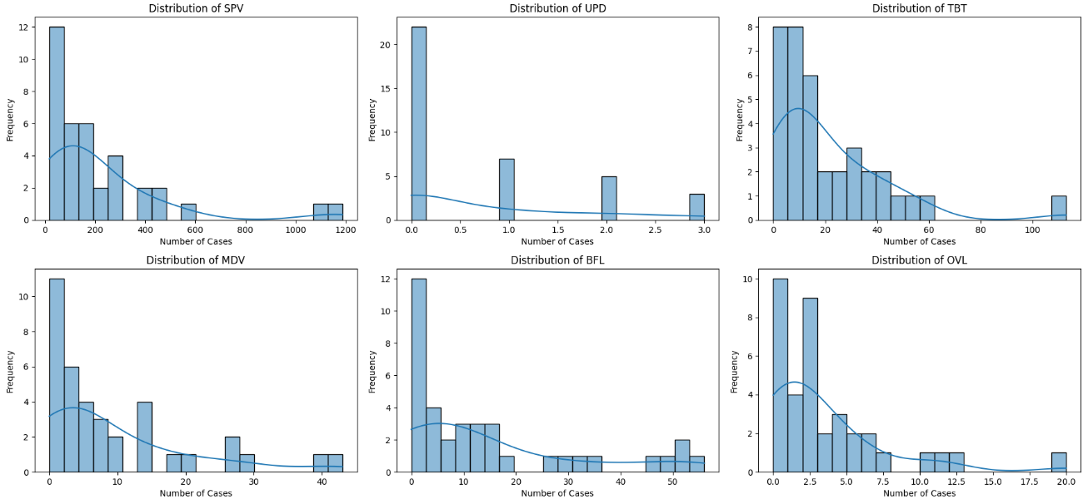
DISTRIBUTION OF CAUSATIVE FEATURES

Slide 15
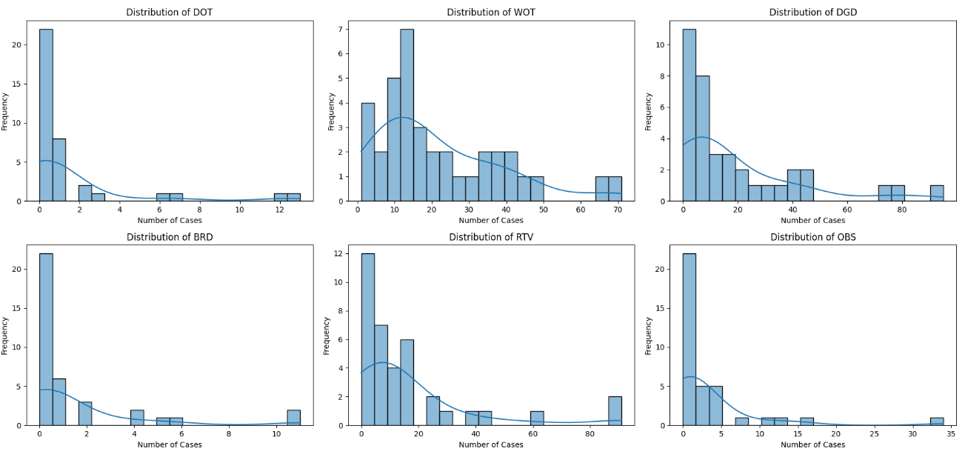

Slide 16
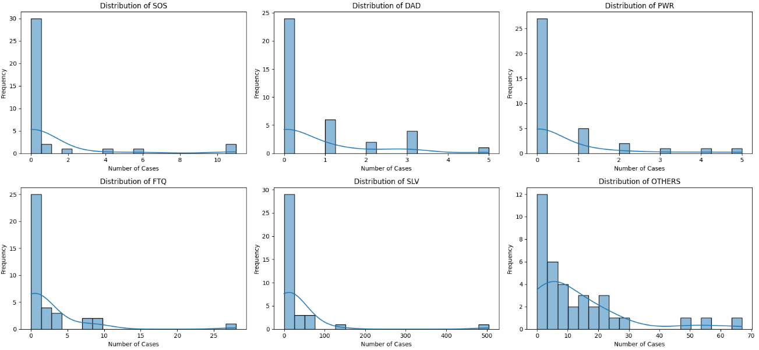

Slide 17
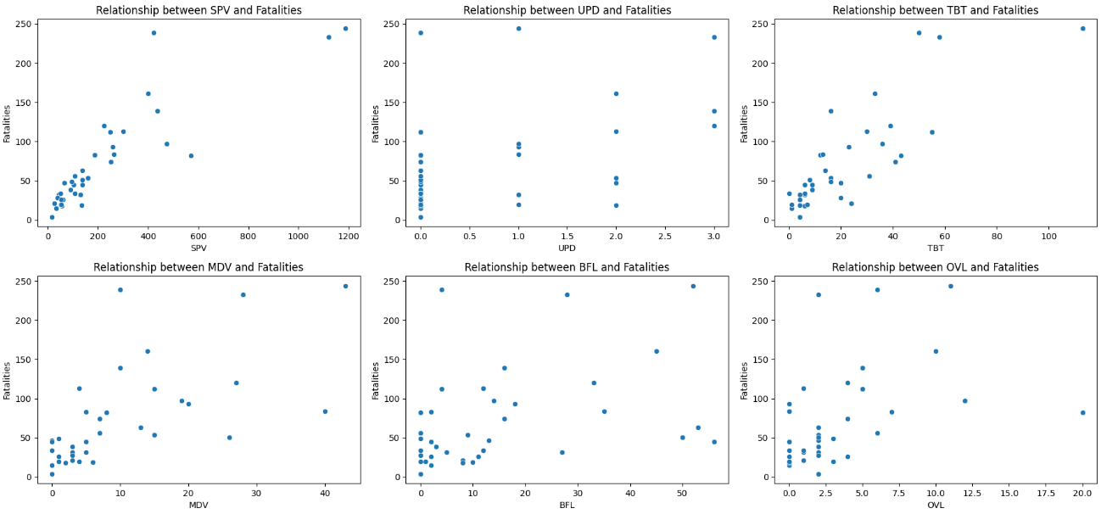
FATAL CASES VS CASUATIVE FEATURES

Slide 18
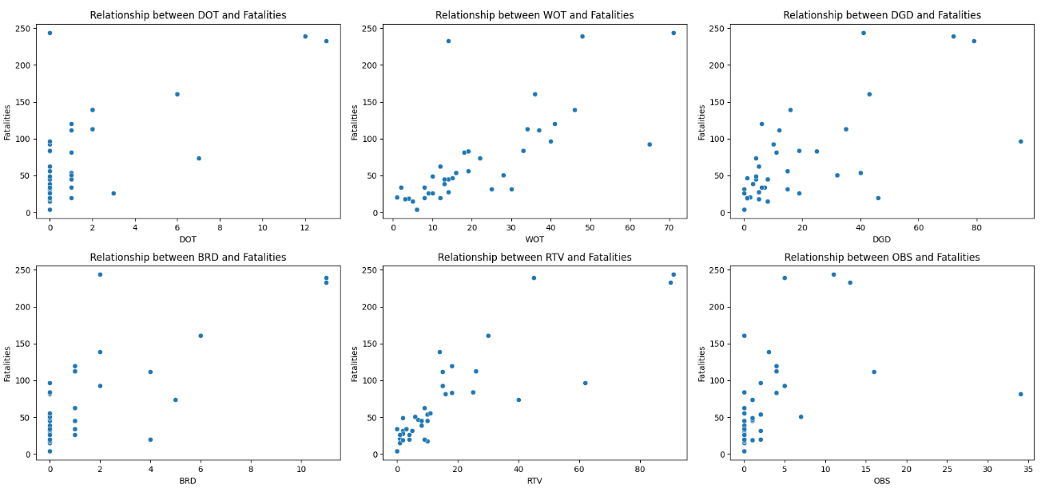

Slide 19
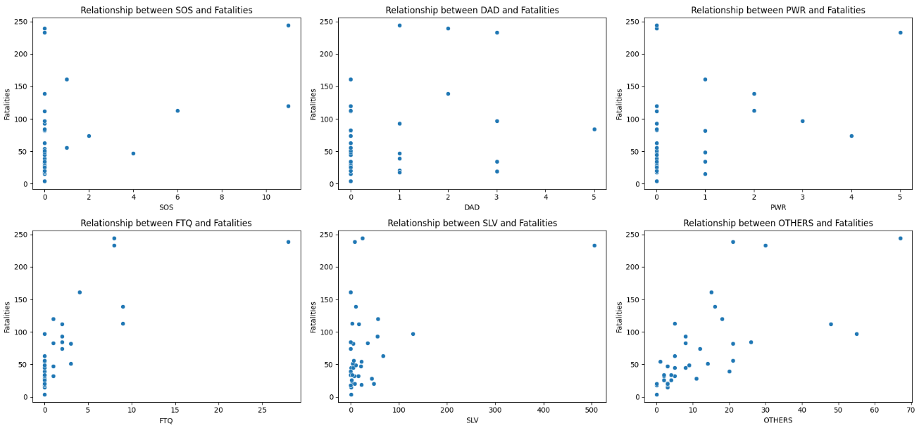

Slide 20
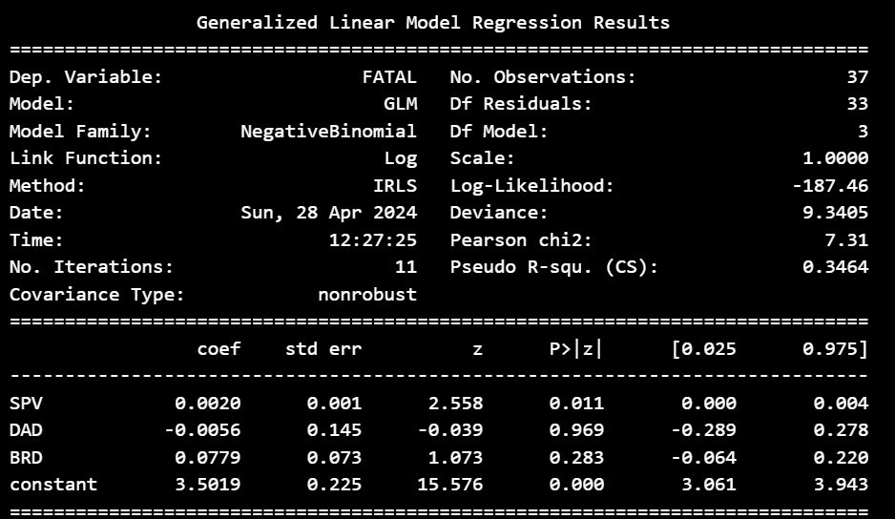
DISCRIPTIVE STATISTICAL RESULT
Fatal Cases and Causative Features Dependencies
Overall, the model suggests that speed violations have a significant positive impact on fatalities, while the influence of driving under alcohol/drug and bad road conditions is not statistically significant in predicting fatalities in road accidents.

Slide 21
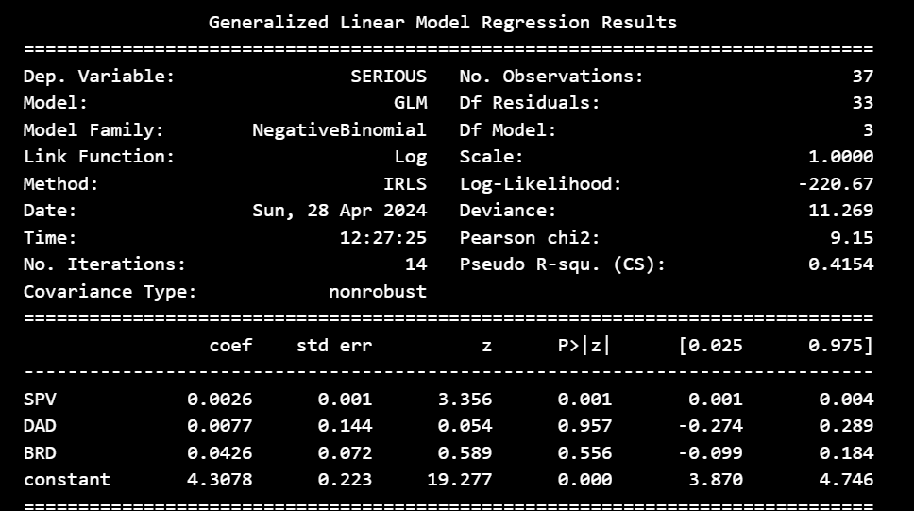
Serious Cases and Causative Features Dependencies
Overall, based on this model, speed violations appear to have a significant impact on the severity of accidents, while the involvement of alcohol/drugs and bad road conditions do not show significant effects.

Slide 22
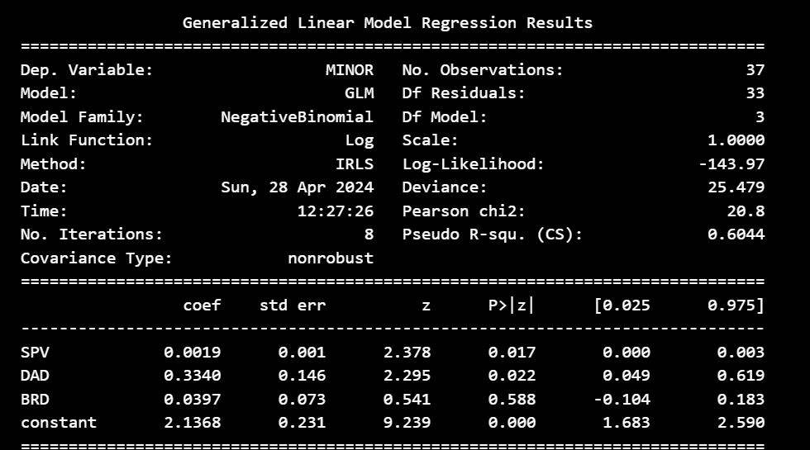
Minor Cases and Causative Features Dependencies
Overall, based on this model, speed violations and driving under alcohol/drug influence appear to have a significant impact on the severity of minor accidents, while bad road conditions do not show a significant effect.

Slide 23
RECOMMENDATIONS
Based on our analysis of the road transport data for the year 2023, we recommend implementing a holistic approach to road safety that addresses the following key areas:
Enhanced Enforcement and Compliance: Strengthen enforcement measures to ensure compliance with traffic laws and regulations, particularly focusing on speeding, drunk driving, distracted driving, and other risky behaviors. This can be achieved through increased police patrols, the use of automated enforcement technologies (e.g., speed cameras), and public awareness campaigns highlighting the consequences of traffic violations.
Infrastructure Improvements: Invest in upgrading and maintaining road infrastructure to enhance safety for all road users. This includes repairing potholes, improving road signage and markings, installing safety barriers and guardrails, and implementing measures to improve visibility and lighting, especially in high-risk areas.
Road User Education and Awareness: Launch comprehensive educational campaigns targeting drivers, pedestrians, cyclists, and other road users to promote safer behaviors and increase awareness of road safety issues.

Slide 24
Recommendations:
Technology Integration: Embrace emerging technologies to improve road safety, such as advanced driver assistance systems (ADAS), vehicle-to-vehicle (V2V) communication, and intelligent transportation systems (ITS).
Community Engagement and Partnerships: Engage local communities in identifying road safety priorities, implementing interventions, and monitoring progress through community-based programs and initiatives.
Data-Driven Decision Making: Continue collecting, analyzing, and sharing road transport data to inform evidence-based policymaking and program development. Invest in data collection systems, analytics tools, and capacity-building initiatives to strengthen data management and analysis capabilities at the national, regional, and local levels.
By adopting a multi-faceted approach that combines enforcement, infrastructure improvements, education, technology, community engagement, and data-driven decision-making, we can work towards reducing road accidents, minimizing injuries and fatalities, and creating safer road environments for all users.

Slide 25
CONCLUSION
In conclusion, our analysis of road transport data for the year 2023 has provided valuable insights into the factors influencing road safety and accident severity. Through a comprehensive examination of various parameters such as speed violations, alcohol involvement, road infrastructure, and other contributing factors, we have identified key trends and patterns that underscore the urgent need for proactive interventions to improve road safety outcomes.
The findings of our analysis highlight the importance of adopting a holistic approach to road safety that encompasses enforcement, infrastructure enhancements, education, technology integration, community engagement, and data-driven decision-making. By addressing these critical areas, we can work towards reducing the incidence of road accidents, preventing injuries and fatalities, and promoting safer road environments for all users.

Slide 26
Furthermore, our recommendations underscore the significance of leveraging data-driven insights to inform policymaking and program development in road transport management. By harnessing the power of data analytics and evidence-based decision-making, policymakers and stakeholders can effectively prioritize interventions, allocate resources efficiently, and monitor progress towards achieving road safety objectives.
In essence, our study emphasizes the imperative of adopting a proactive and collaborative approach to road safety, underpinned by robust data collection, analysis, and utilization mechanisms. By working together and leveraging data-driven insights, we can strive towards creating safer, more sustainable, and more resilient road transport systems that benefit individuals, communities, and societies as a whole.

Slide 27
Q&A
Q: How did you collect and analyze the road transport data for 2023?
A: We collected Q1 to Q4 road transport data from the national bureau of statistics database nigeria. The data was merged, then cleaned, processed, and analyzed using statistical methods to identify trends and patterns.
Q: What were the main findings of your analysis regarding road safety in 2023?
A: Our analysis revealed several key findings, including an increase in road accidents due to speeding violations, the impact of alcohol involvement on accident severity, and the role of road infrastructure in mitigating accidents.
Q: How do you plan to implement the recommendations provided in your presentation?
A: Implementing the recommendations will require collaboration between various stakeholders, including government agencies, law enforcement, transportation departments, and community organizations. We plan to work closely with these stakeholders to develop and implement targeted interventions, such as increased enforcement, infrastructure improvements, public awareness campaigns, and policy reforms.
Q: How do you plan to measure the success of your road safety initiatives?
A: We plan to measure the success of our initiatives through key performance indicators such as the reduction in road accidents, injuries, and fatalities, improvements in traffic flow and congestion levels, and public perception surveys.

Slide 28
THANK YOU
PRESENTATION
BY
ARIJEH OLAYINKA OLUWASEYI
arijeholayinka@gmail.com
09066668005

